Slide 1
XYZ Ads Airing Report Analysis
Final Project-3

Slide 2
PROJECT DESCRIPTION
TV Airing Brands, their product, their category. Dataset includes the network through which Ads are airing, types of network like Cable/ Broadcast and the show name also on which Ads got aired. You can also see the data of Dayparts, Time zone and the time & date at which Ads got aired. IT also includes other data like Pod Position (the lesser the valuable), duration for which Ads aired on screen, Equivalent sales &, total amount spent on the Ads aired.
APPROACH
I have analyzed the database carefully. Observed all the tables, columns, rows. Afterwards check all the content carefully. Then one by one I have executed queries according to the questions asked. In this project I have learned a lot of new things like how to manipulate data, analyze the data and many more.
TECH-STACK USED
Microsoft PowerPoint allows you to create various types of documentation and prepare reports. Microsoft Excel enables users to format, organize, analyze data, and calculate data in a spread sheet, and users can make information easier to view as data is added or changed.
INSIGHTS
I have gained knowledge of various Google sheet functions which helped me to solve the questions asked in this project. The following are the functions I used: AVERAGEIFS, IF Function and OR Function. I used a pivot table to create charts.
RESULT
By completing the project, I feel more confident in Microsoft Excel knowledge, as this helped me to gain more knowledge about the report to perform better.

Slide 3
A, What is Pod Position? Does the Pod position number affect the amount spent on Ads for a specific period of time by a company? (Explain in Details with examples from the dataset provided)
POD POSITION
An Ad Pod is a sequence of ads played back to back during a break and pod position denotes the sequence number at which the respective ad will be played.
In the next slide, we can see a Chart for Pod Position and Average Amount Spend for the Ad by different companies.
We can summarize that for every brand the Amount Spend decreases gradually with respect to the Pod Position(from 1 - 31) except for Pod position 26 which has a higher spend then all the pods.
For each car manufacturer, as the pod position increases, prices increase earlier and then start declining

Slide 4
INSIGHTS:
For each car manufacturer, as the pod position increases, prices increase earlier and then start declining

Slide 5
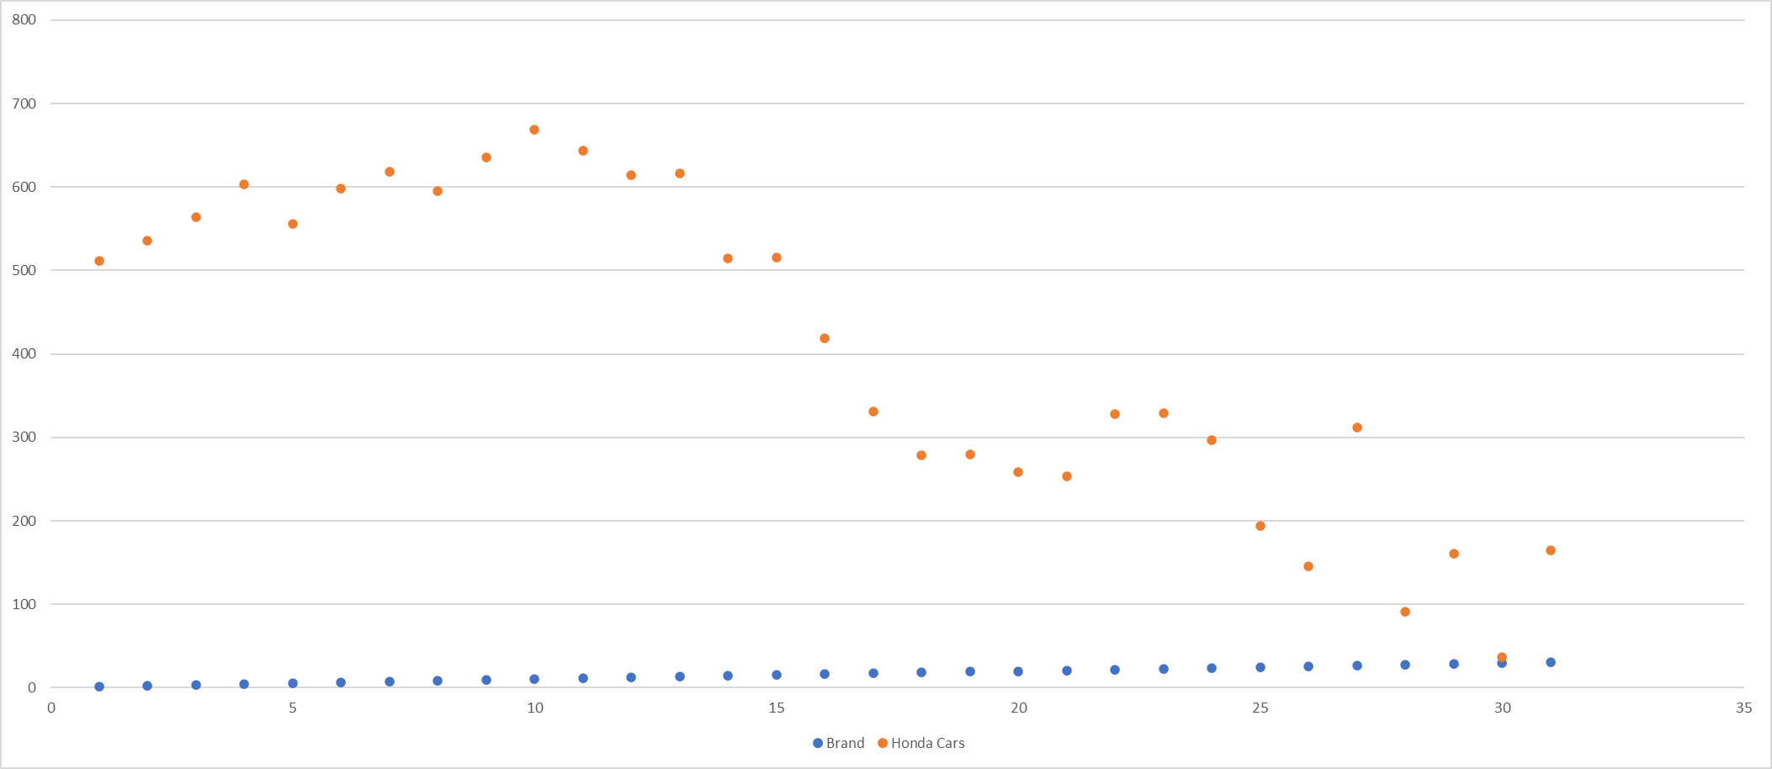
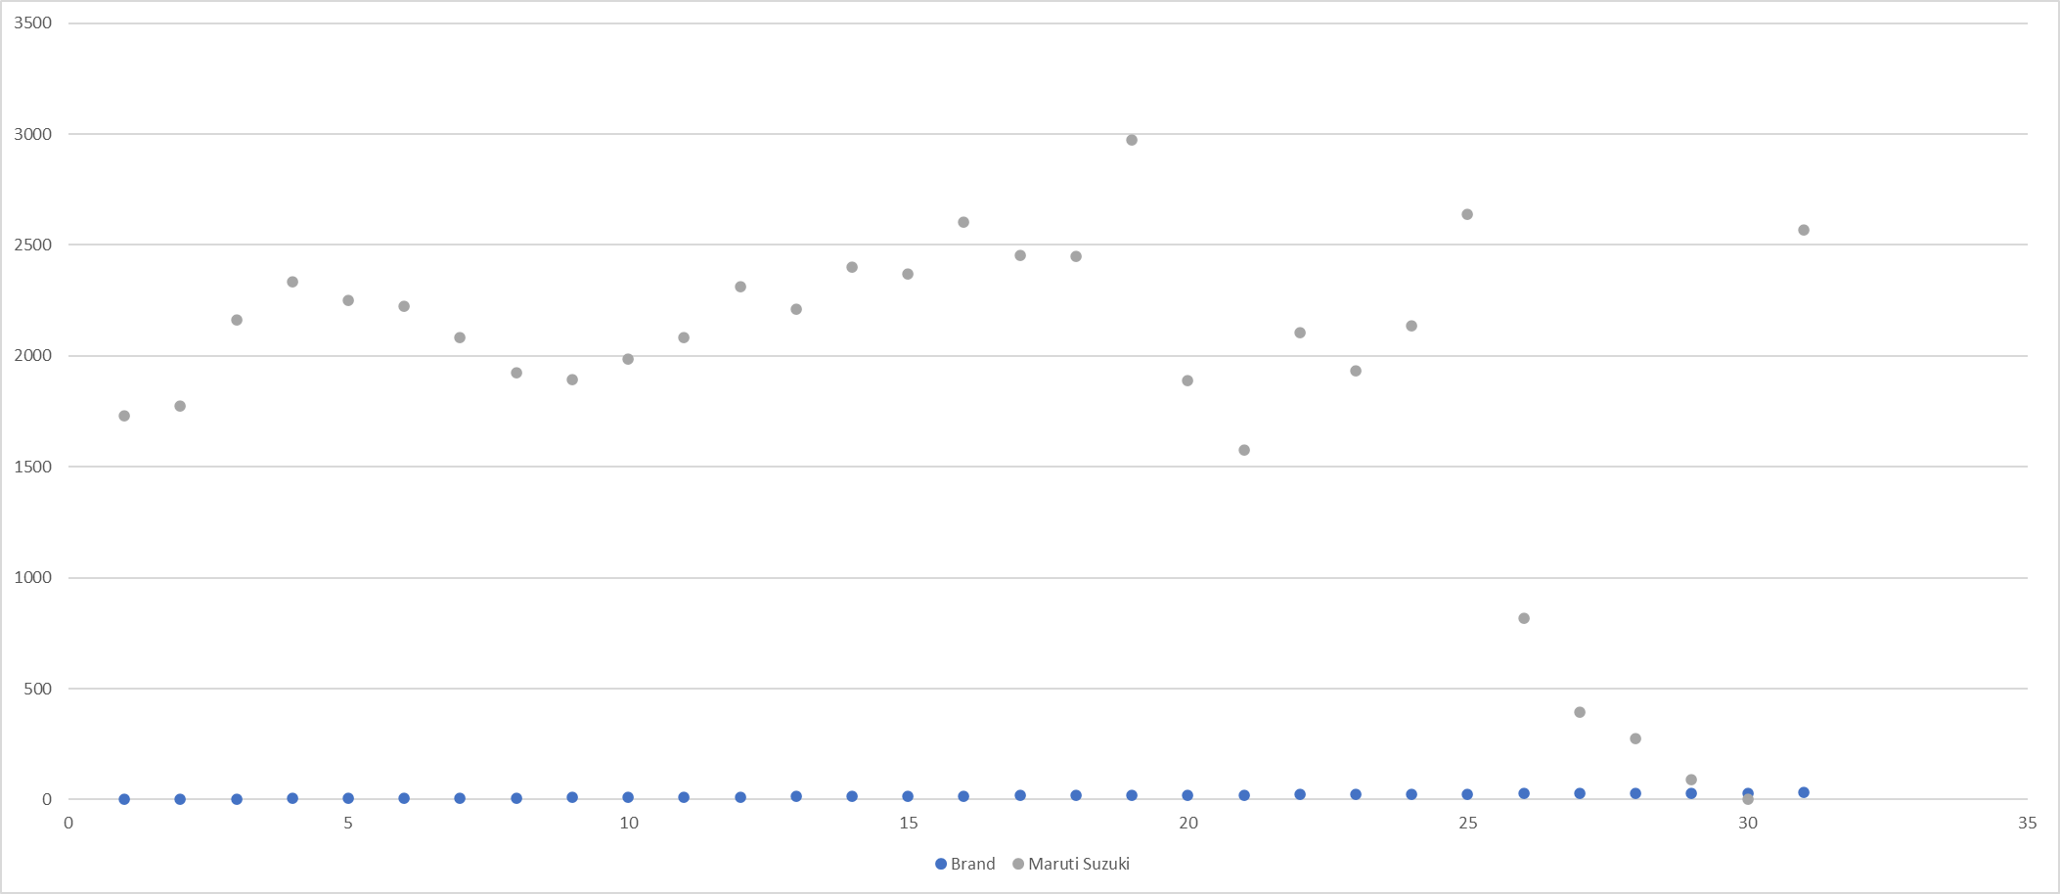
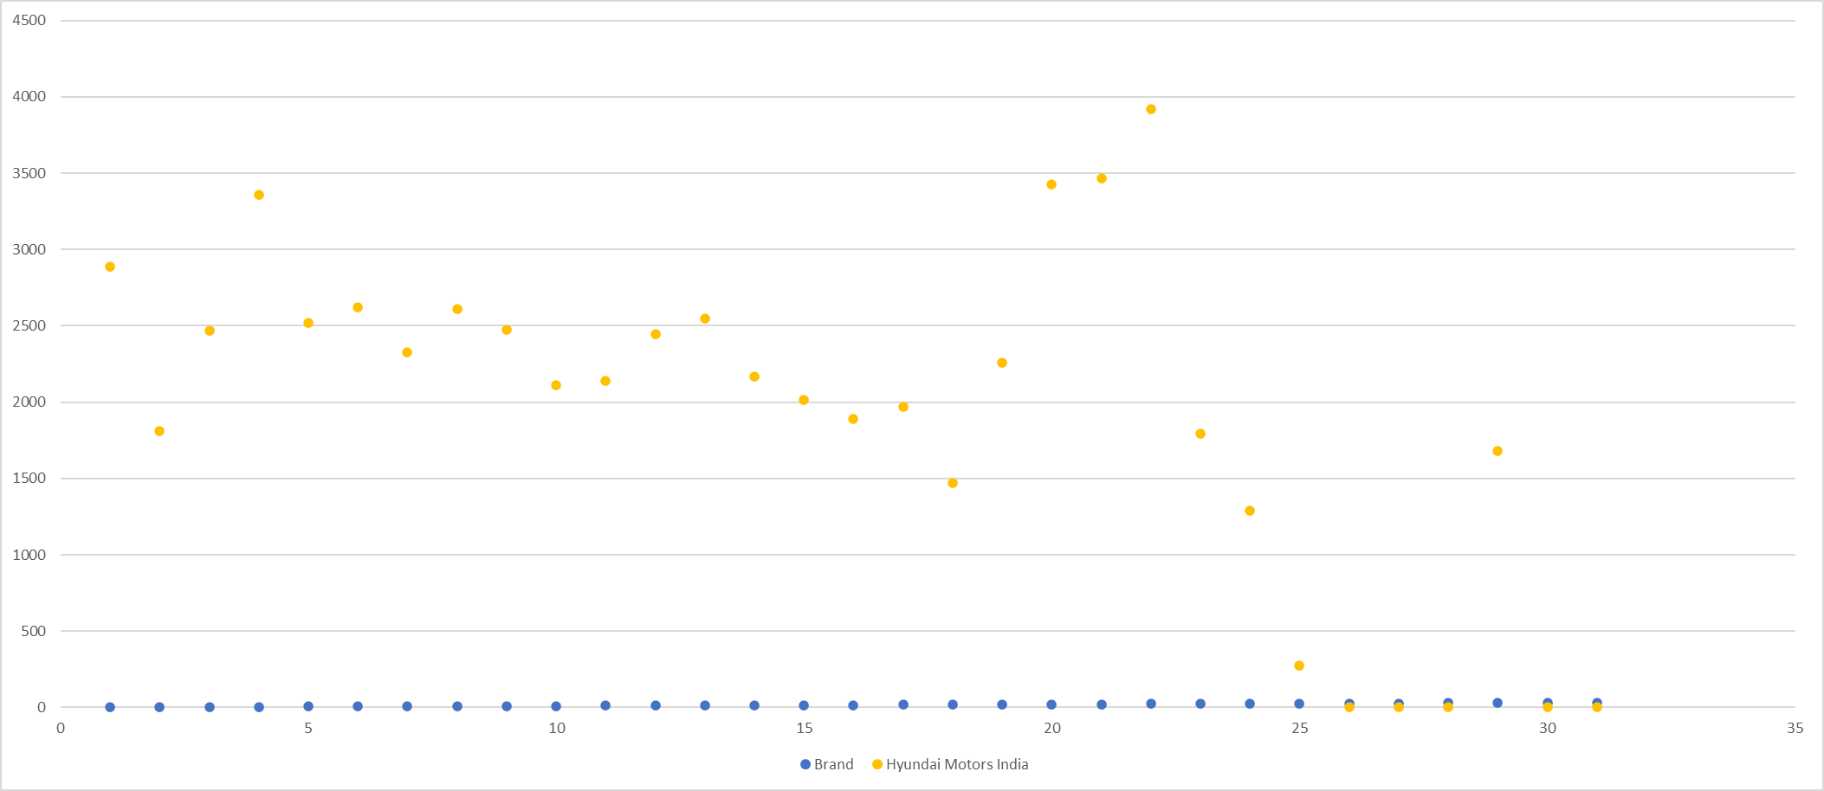

Slide 6
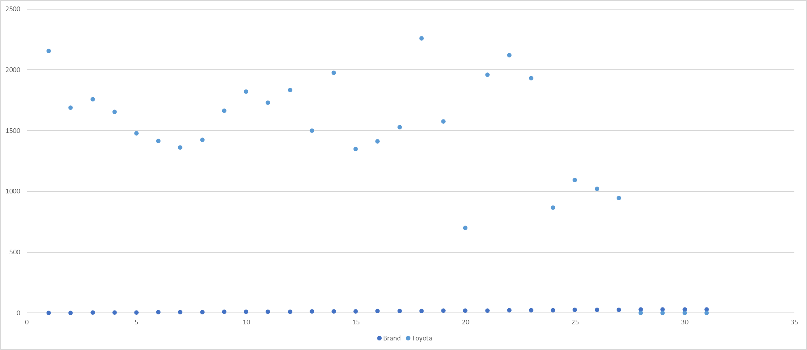
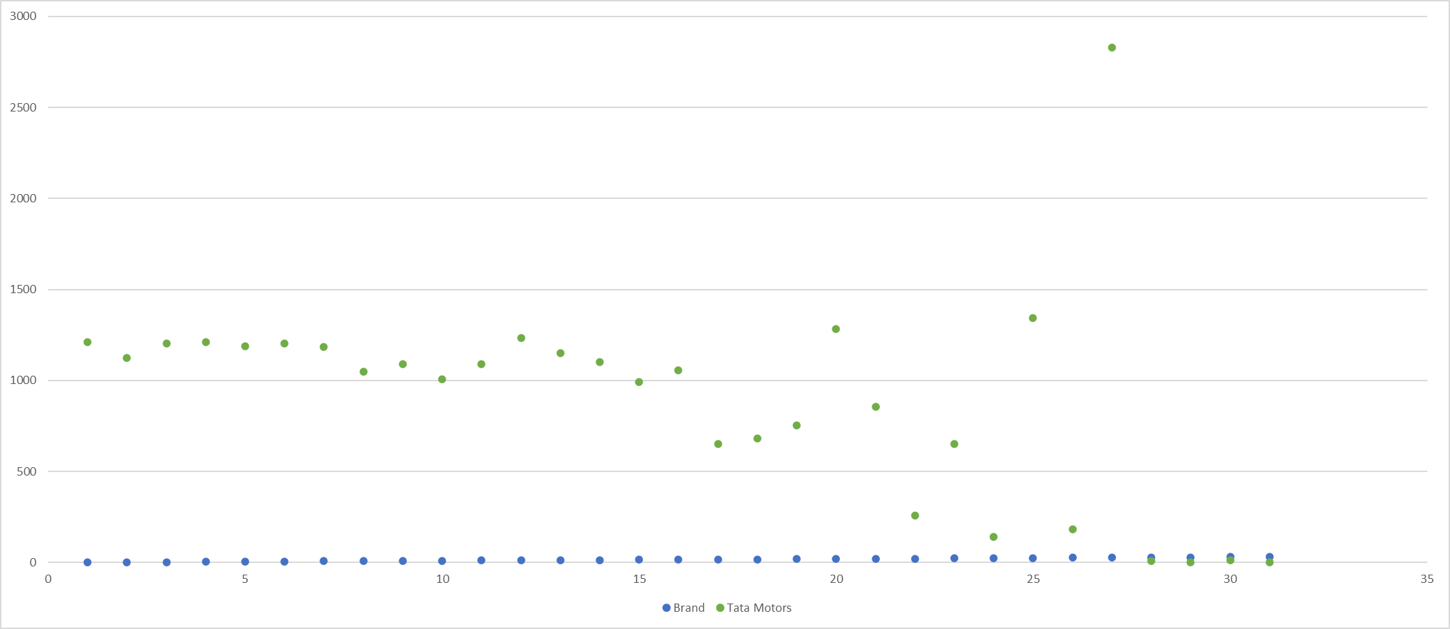
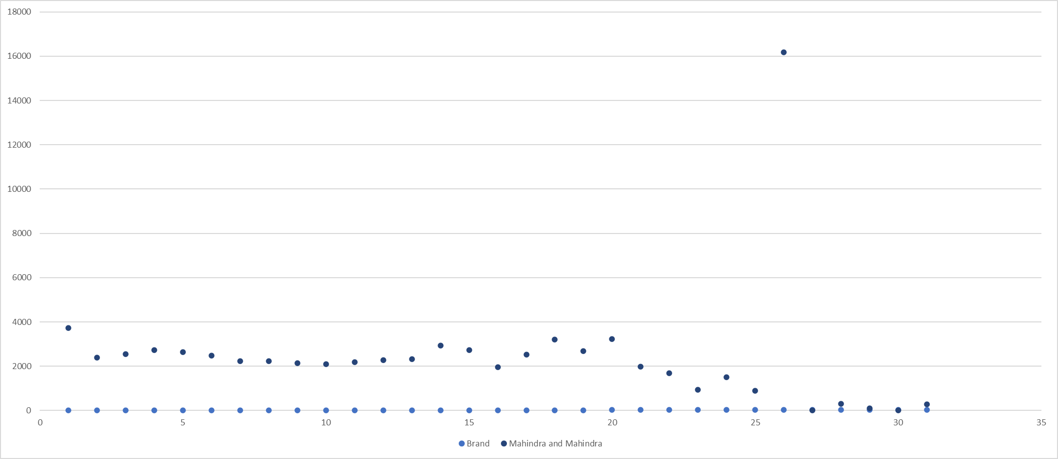

Slide 7
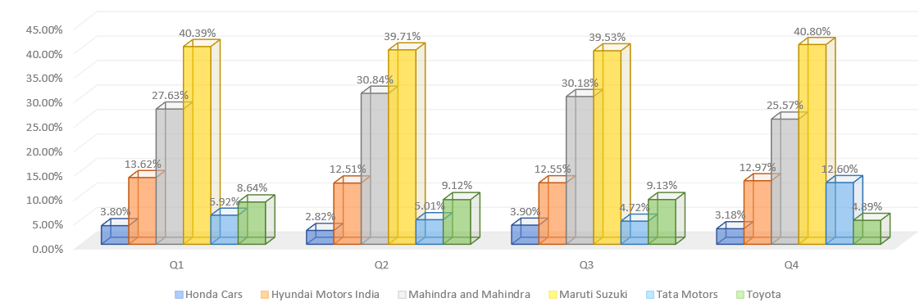
B, What is the share of various brands in TV airings and how has it changed from Q1 to Q4 in 2021?
INSIGHTS:
We can see the Maruti Suzuki Brand Hits highest and most valuable position in almost every quarter.
The above graph depicts a decreasing-increasing trend between the 4 quarters.
QUATERLY DISTRIBUTION OF ADS AS PER TOTAL SPEND

Slide 8
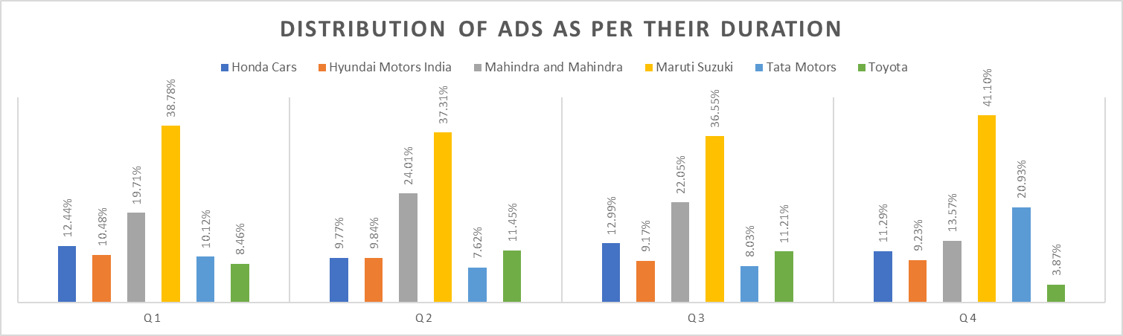
INSIGHTS:
In case of duration also Maruti Suzuki hits the highest position in every quarter.
Mahindra and Mahindra acquire the second highest position in every quarter.

Slide 9
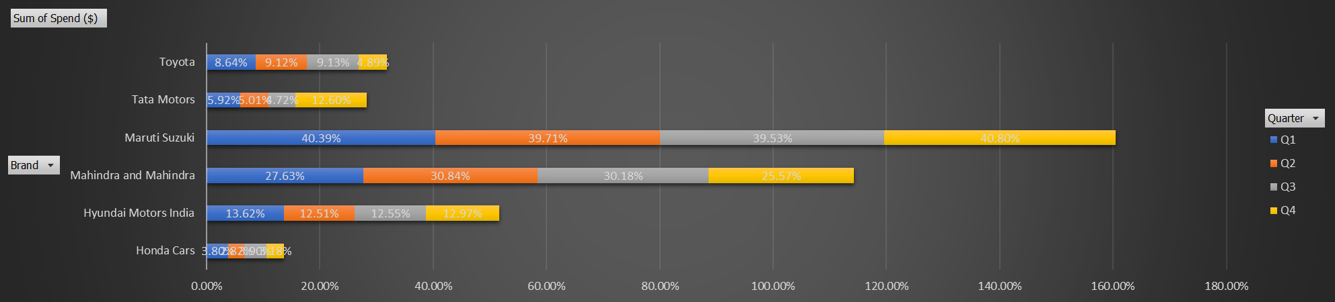
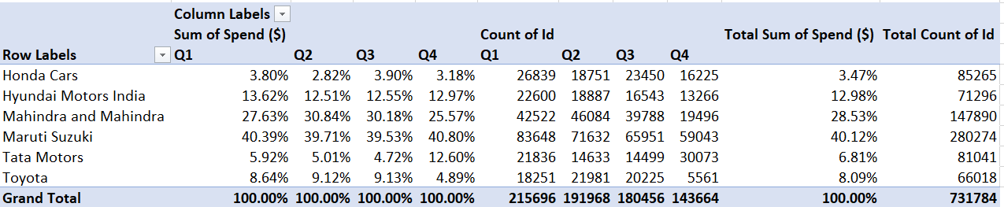
INSIGHTS:
we can see that the Amount of Spend & Number of Ads increases quarterly for Tata Motors and both Amount Spend & Ad Count drastically increases in Quarter 4 for Toyota. For rest of the brands, Ad Expense & Count both decreases gradually

Slide 10
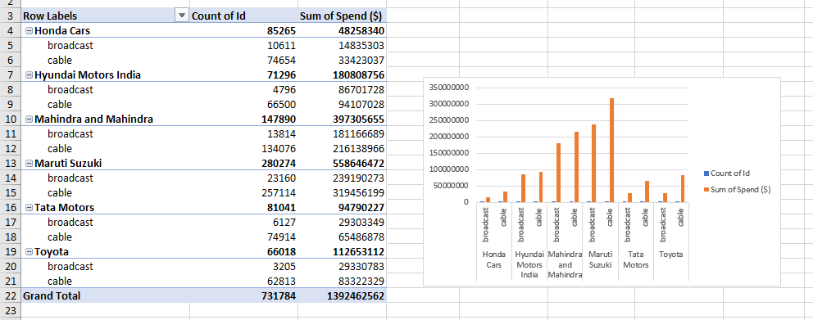
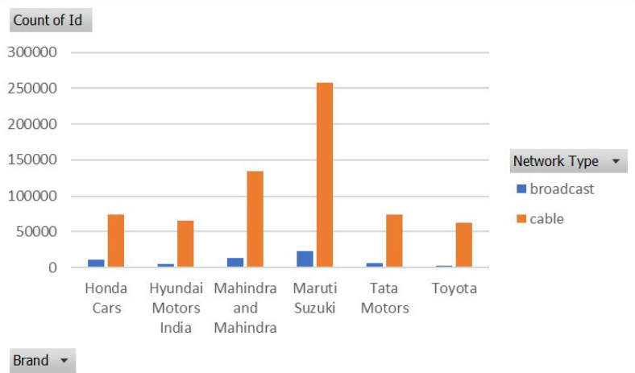
C, Conduct a competitive analysis for the brands and define advertisement strategy of different brands and how it differs across the brands.
INSIGHTS:
All competitors spend more on cable vs broadcast
Maruti Suzuki does the maximum Ads compared to other Brands.

Slide 11
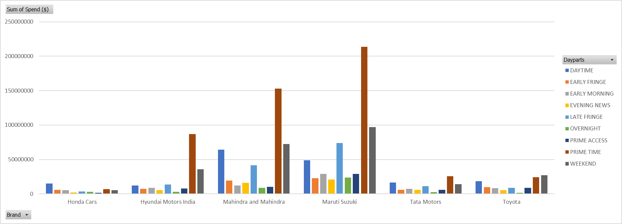
INSIGHTS:
we can see that brands like Maruti Suzuki, Mahindra and Mahindra, Hyundai Motors India spend maximum amount on the “Prime Time”

Slide 12
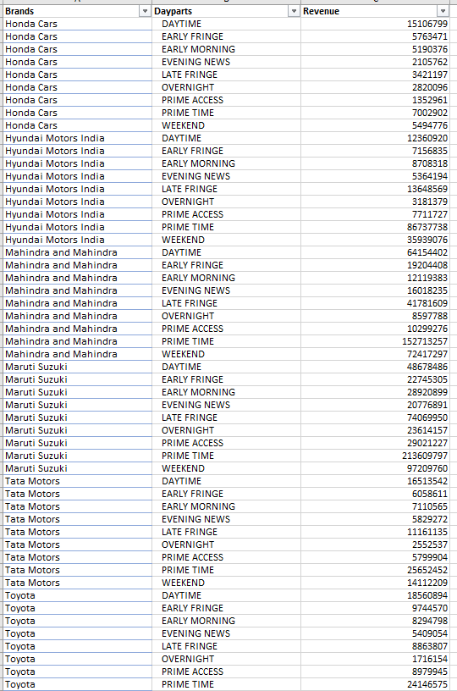

Slide 13
D, Mahindra and Mahindra wants to run a digital ad campaign to complement its existing TV ads in Q1 of 2022. Based on the data from 2021, suggest a media plan to the CMO of Mahindra and Mahindra. Which audience should they target?
INSIGHTS:
“Day Time” & “Prime Time” are the time when the Ads should be aired as they have the maximum ads published or maximum ads price which means maximum audience.

Slide 14
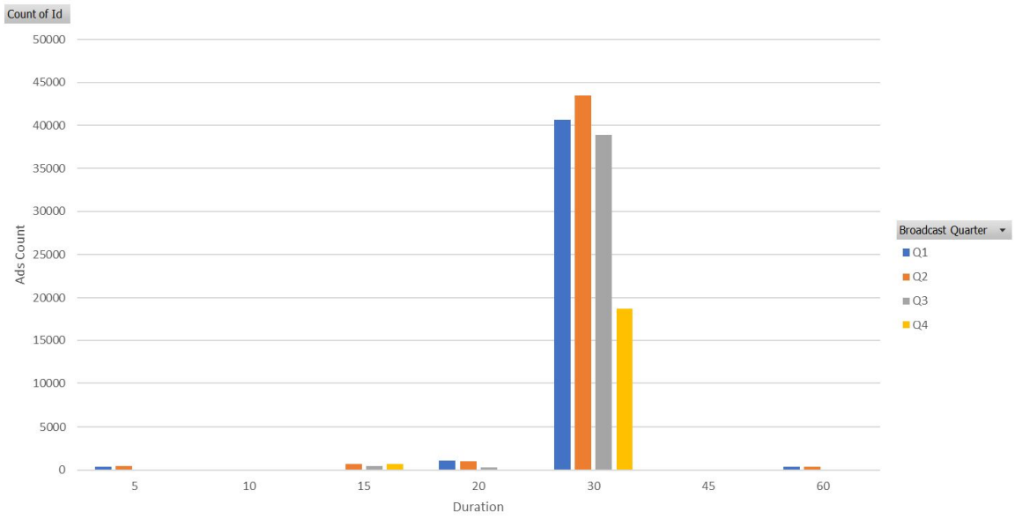

Slide 15
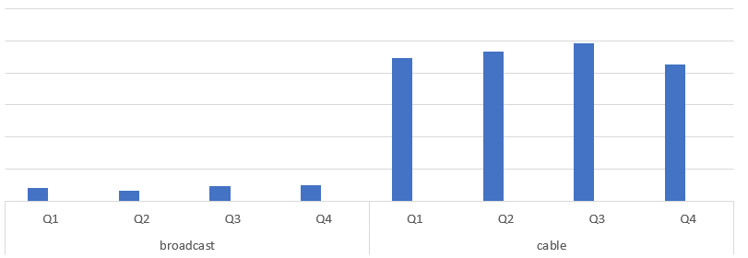

Slide 16
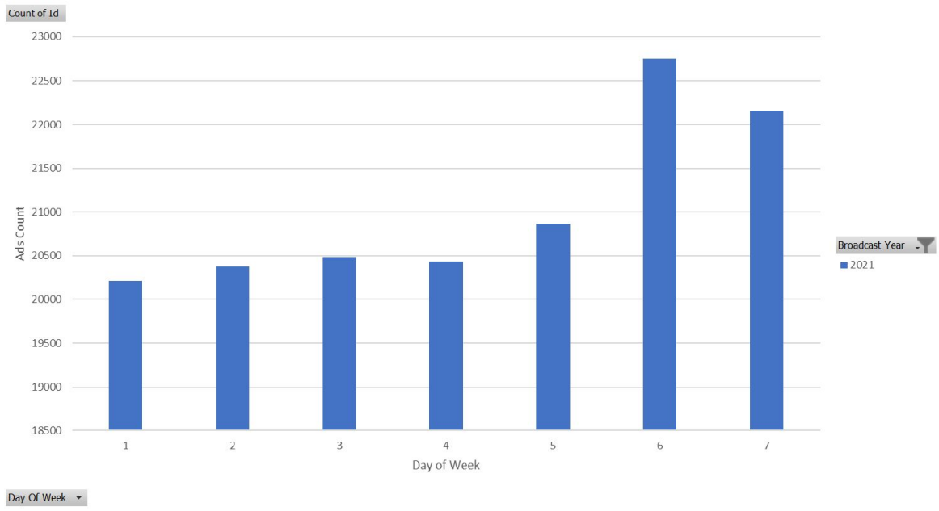

Slide 18
INSIGHTS:
They should target audience who are interested in Mahindra Thar, as that is the Car which has maximum Ads aired over Cable.
“Day Time” & “Prime Time” are the time when the Ads should be aired as they have the maximum ads published or maximum ads price which means maximum audience.
Ads were running mostly on Cable network type and from Q2 to Q4, there was decrease in the ads duration in all the channels.
Hence, we can say that for Digital Ad we can use the same strategy as people/audience would be during these times.
Also, publishing Ads during weekend would be a good strategy as major amount of
the audience is free during weekends

Slide 19
THANK YOU
Project done by
kaviya

